Slide 1
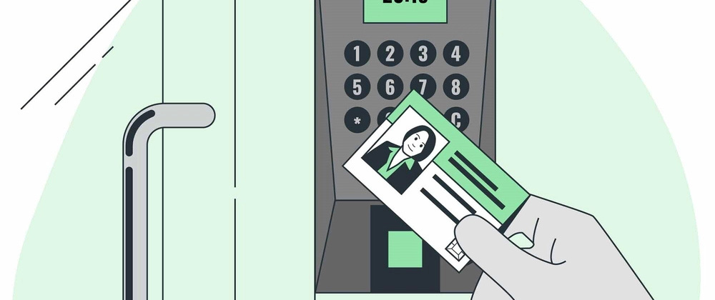

RFID AUTOMATIC CLASSROOM ATTENDANCE SYSTEM
Using ESP32, Google Sheets and Azure Logic Apps
By- Aujaswani, Jasmine
July 24, 2025

Slide 2
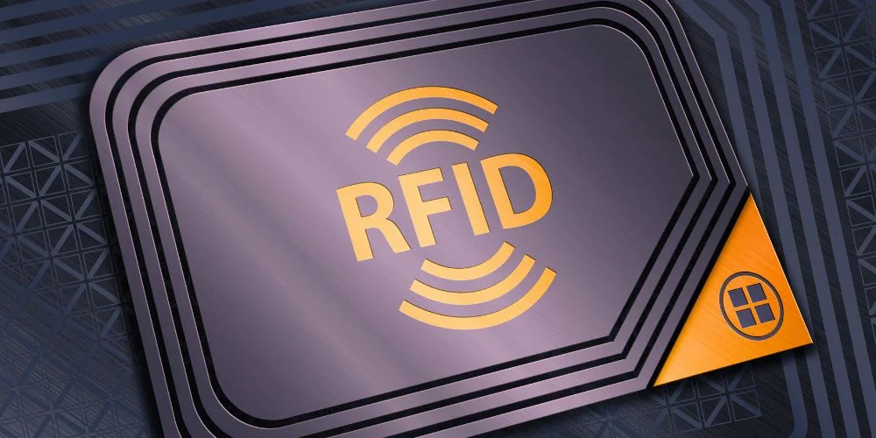
INTRODUCTION
RFID (Radio Frequency Identification): A wireless technology that uses electromagnetic fields to identify and track tags attached to objects.
Key Components:
RFID Reader (e.g., RC522)
RFID Tag/Card (with unique UID)

Slide 3
INTRODUCTION
How It Works: Reader emits signal → Tag responds with UID → UID is read and processed
Widely used in inventory, security, and now, smart attendance systems

Slide 4
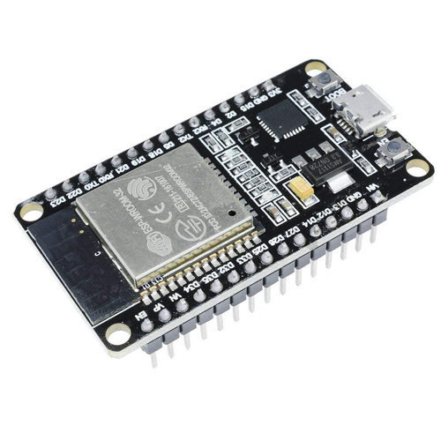
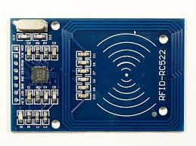
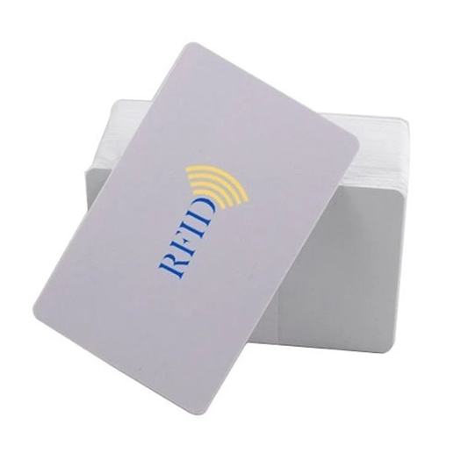
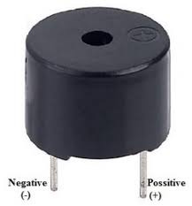
HARDWARE USED
The following hardware was used in achieving the project goal:
ESP 32 Microcontroller
RC522 RFID reader
RFID cards
Active Buzzer

Slide 5


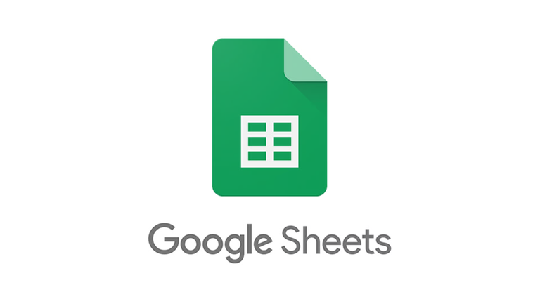

SOFTWARE USED
The following software was used in achieving the project goal:
Arduino IDE
Google Apps Script
Google Sheets
Azure Logic Apps

Slide 6


PROJECT OVERVIEW
Automates attendance using RFID cards
Logs student UID with timestamp in Google Sheets
Classifies attendance as "On Time" or "Late"
Sends daily attendance report to professor
Cloud-integrated and fully automated

Slide 7
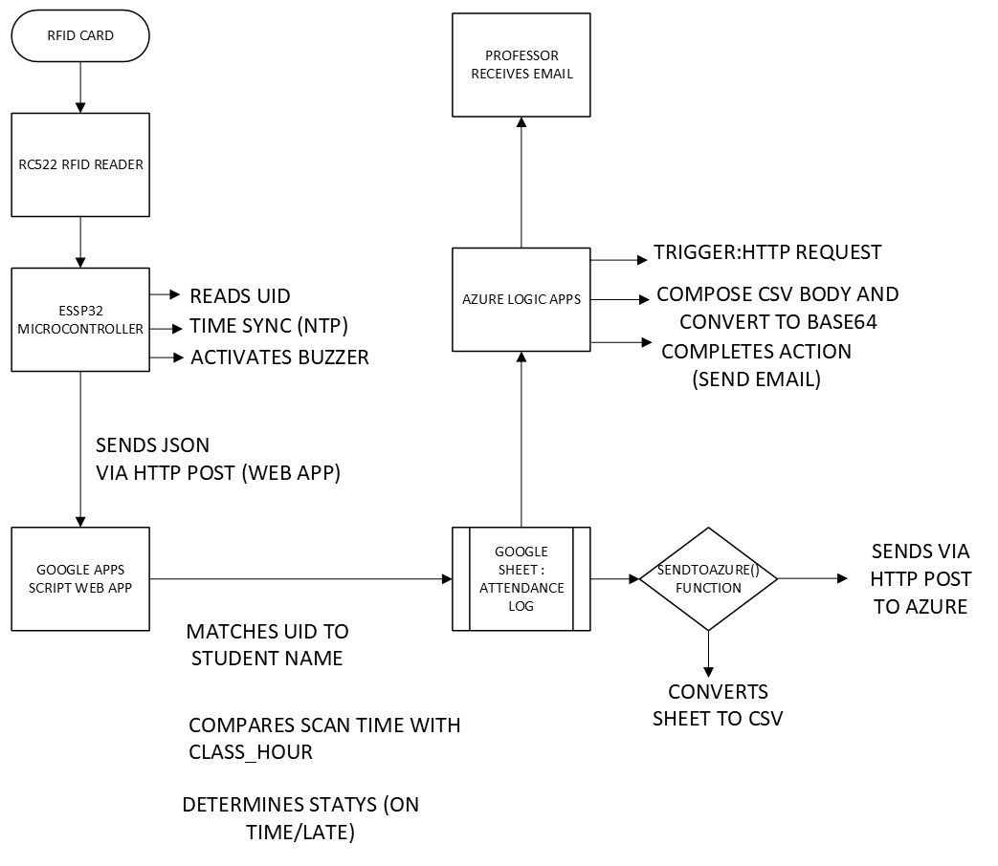
W
O
R
K
F
L
O
W

Slide 8
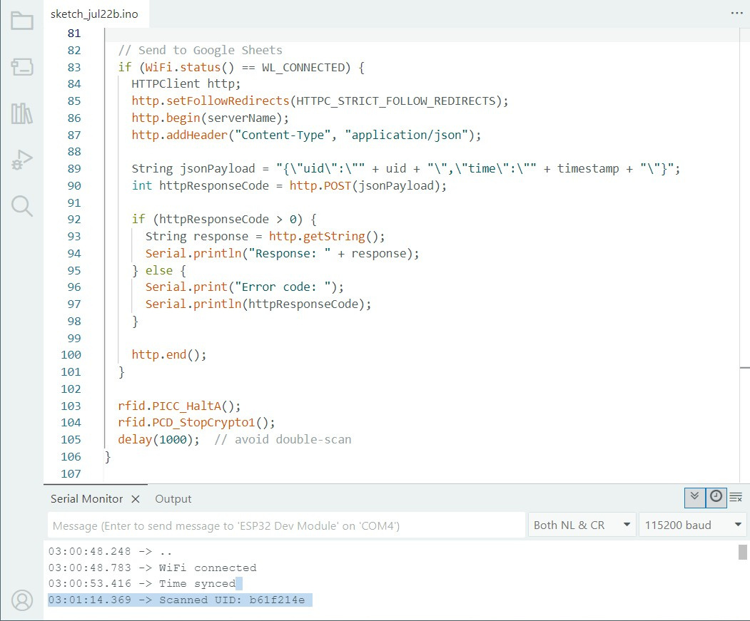
Serial monitor output from ESP32 sketch

Slide 9
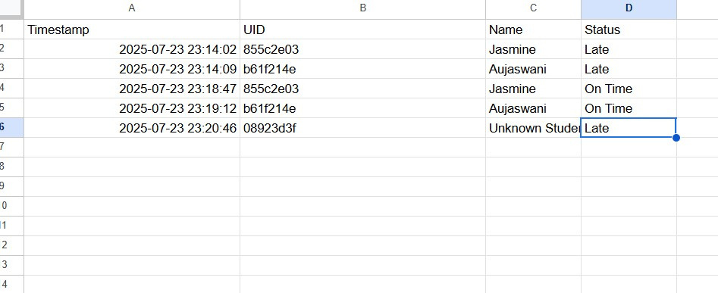
Google sheet updates in real time

Slide 10
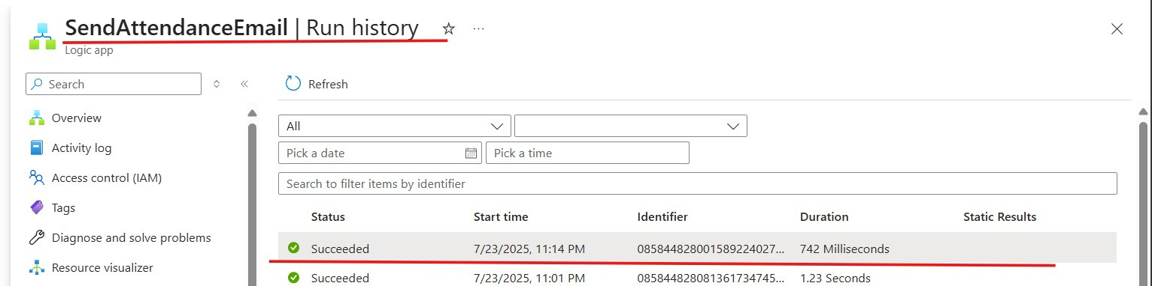
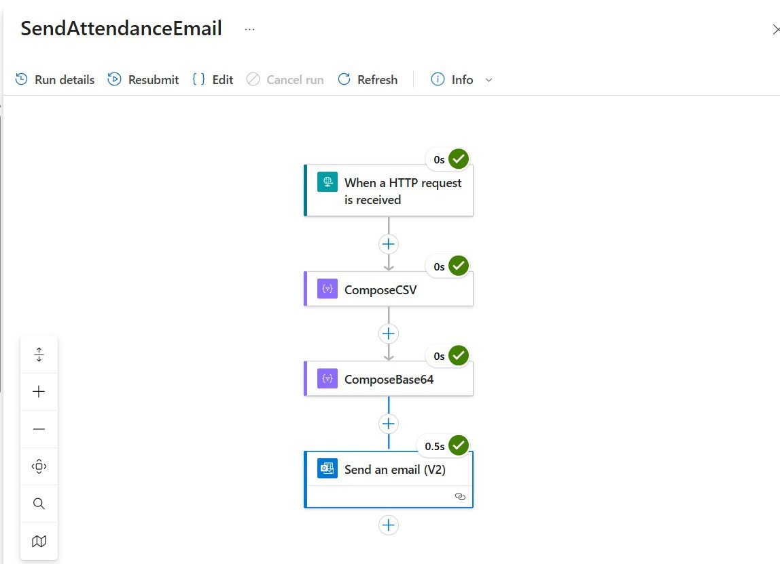
Azure Logic Apps Workflow

Slide 11

Presented By : Aujaswani and Jasmine
THANK YOU

